Slide 1
Financial Aid Self-Service
Notes:
Updated 8-18-15, 2015

Slide 2
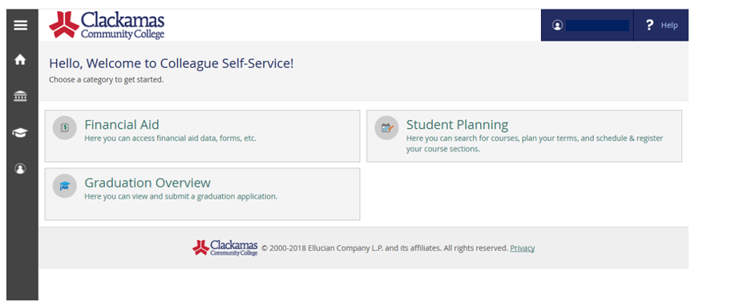
Self-Service Welcome Page
Notes:
The Office of Financial and Scholarship is excited to announce the launch of Self-Service Financial Aid pages for our students. This new service will allow students to view requirements, review their next steps, accept and decline aid, print awards, as well as providing helpful links and resources. Students simply log into their myClackamas, go to self-service and click on the financial aid tab.

Slide 3
Drop-down Menu for Navigation
Hover activates drop-down menu
Notes:
After clicking on Financial Aid, the student can navigate though the pages by hovering over ‘Financial Aid’ and activating the drop-down menus. We will review the different pages, the information provided and the actions student can take.

Slide 4
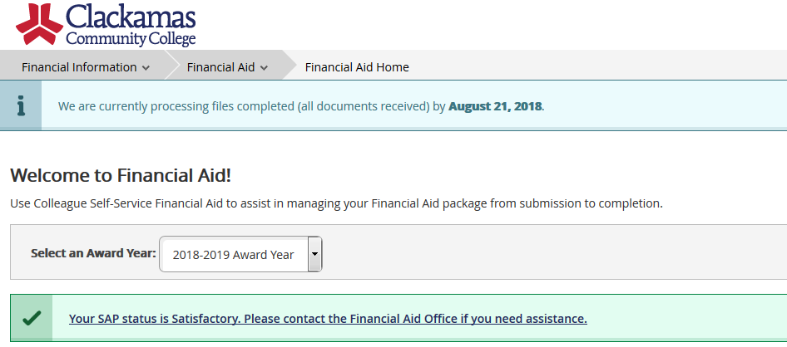
Home Page
Notes:
From the Home Page, students can review current processing date, view their current Satisfactory Academic Progress status and navigate to specific award years. At this time, 2017-2018 and 2018-19 year are available.

Slide 5
Checklist Status:
All requirements completed!
Missing requirements
Notes:
The next portion of the home page lists the status of the student required documents. Check lists are colored coded to draw attention to action items. Clicking on the link will forward to the listing of required documents.

Slide 6
Complete and Needed Documents (Student with completed and needed documents)
Notes:
The check list provides a list of incomplete documents and completed documents. Documents requiring forms have links that will take the student directly to the form needed.

Slide 7
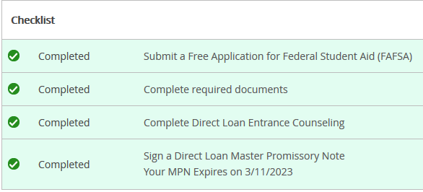
Checklist Items
Completed Checklist
Incomplete Checklist
Notes:
As items are completed they are displayed as such.

Slide 8
Document Status
Student “A” – completed items
Student “B” – missing items
All form requests include a hotlink to the specific form needed!
Notes:
Student can also access their documents from the drop down menu and then click on the Required Documents option.

Slide 9
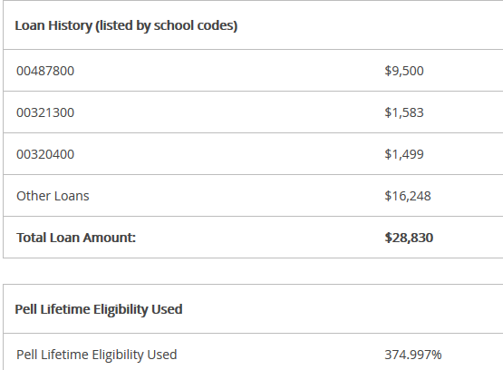
Loan and Pell History
Notes:
The students current loan and Pell history is listed on the home page. Loans are listed out by each school code that the student has attended. Unfortunately, we are unable to provide this list by name, but we do list the National Student Loan Date System link with our helpful links so student may log in using their FSA ID to review the information.

Slide 10
Resources and Links
Notes:
On the right side of the home page, student are able to view and access helpful resources and links. Under the forms, the most common accessed forms are listed. Under the helpful links, other resources that are useful to students are listed, such as links to our foundation scholarships and the FAFSA.

Slide 11
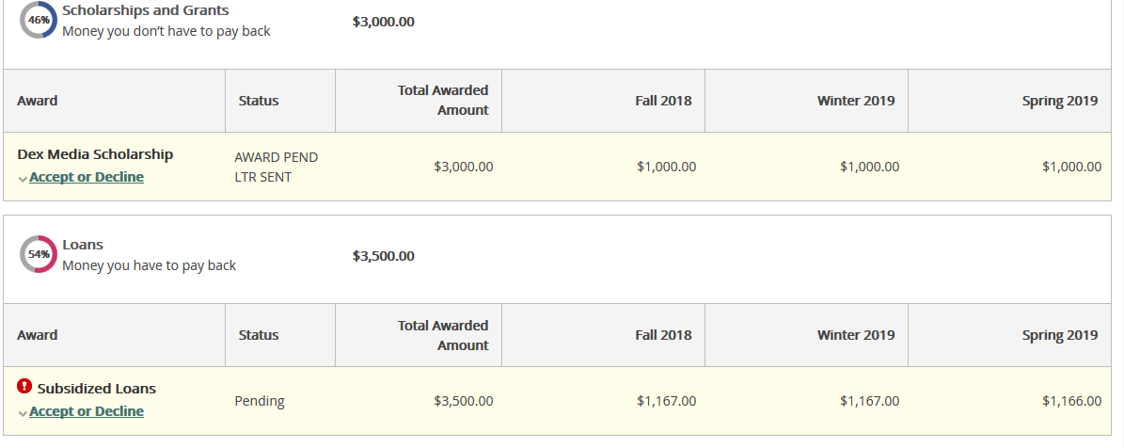
My Awards ready to accept/decline (shows yellow)
Notes:
Student can access their award information when they click on My Awards from the drop down menu. Aid is grouped together by Scholarships and Grants and then loans, with a percentage indicating the ratio. This aid need action which is indicated by the yellow background.

Slide 12
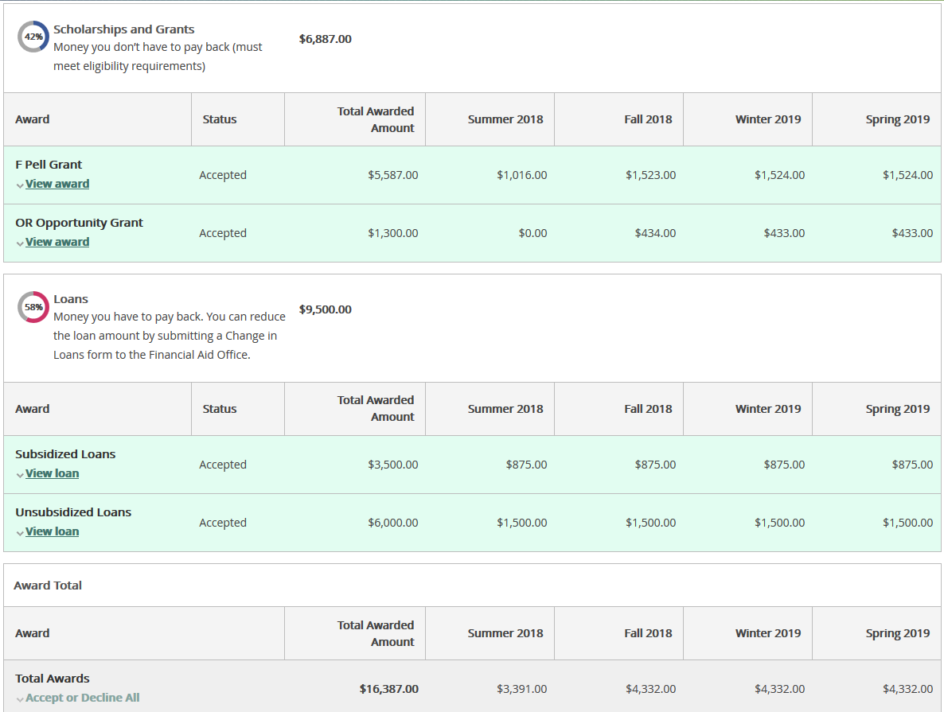
After accepted/declined (turns green)
Notes:
Once the student accepts their aid, the information turns green.

Slide 13
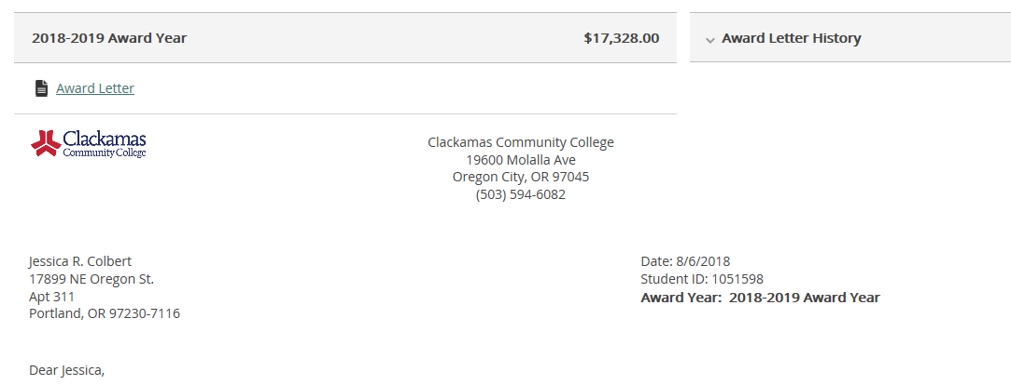
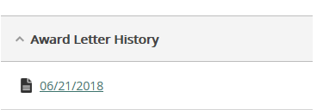
Award Letter
Previous Award Letters
Notes:
After the student has accepted and/or declined their aid, they are able to navigate Award Letter from the drop down menu. From this page student are able to view their completed award letter with printing options. The student award letter history is list on this page so students are able to compare award letter when any revisions are made.

Slide 14
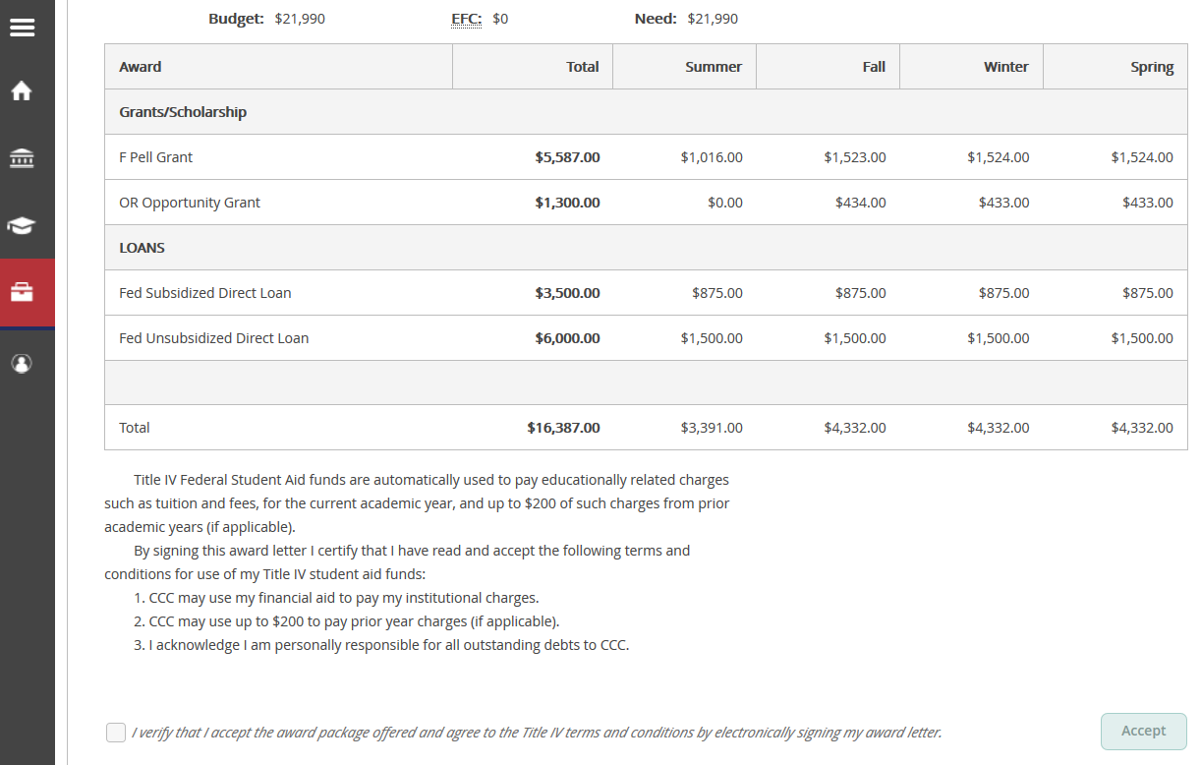
Award Letter Terms and Conditions
Notes:
The award letter that is generated indicates the aid the student had accepted.

Slide 15
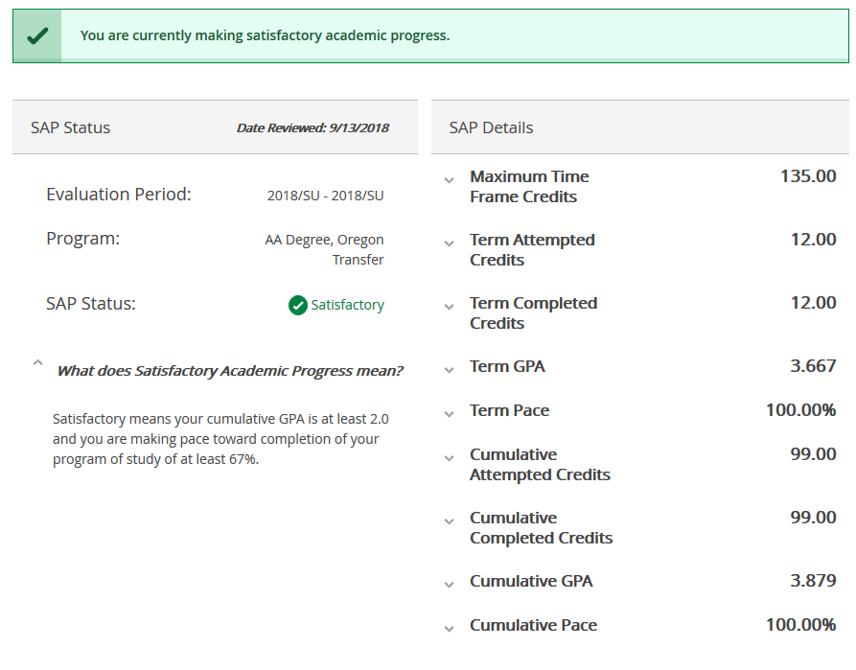
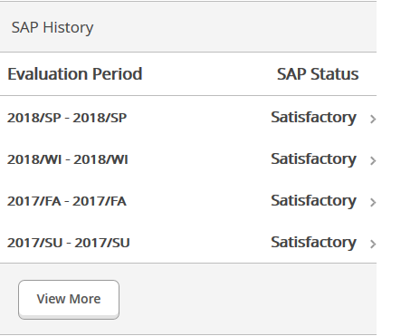
Satisfactory Academic Progress (SAP) and History
Notes:
Students are able to review their current Satisfactory Academic Progress (SAP) status as well as their history. Their current status is listed at the top of the page and is colored code according to their status. Status information includes the last date their status was calculated and for which term, their current program, and an explanation of the status. Details include information used to calculate the students current status such as their cumulative GPA and cumulative credit hours.

Slide 16
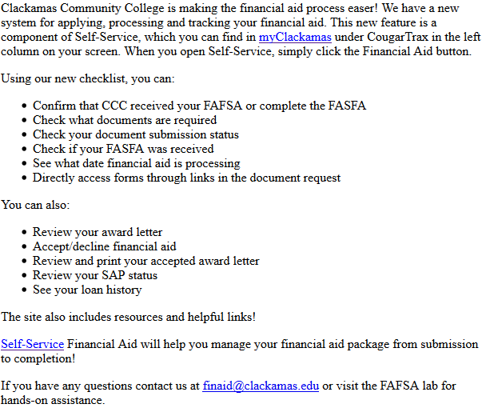
Communication Plan
On October 3rd all Financial Aid students received an email announcing Self-Service:
Table Tents are being distributed to all three campuses.
Flyers are being distributed to all three campuses.
All outgoing communication to financial aid students will include a direct link to Self-Service:
https://selfservice.clackamas.edu/Student/
Notes:
Financial aid students have received an email to communicate our new self-service pages. Table tents and fliers have been distributed across all three campuses and information has been posted on our reader boards.

Slide 17
“Student Experience” Tester Comments
“It was nice seeing my current financial aid (SAP) status along with other documents listed to the right side as opposed to having to go through different links to find this information.”
“The checklist is very convenient and easy to find. “
“I love the resources links! The FAFSA link, IRS Tax link, and NSLDS are my favorites!.”
“I find the Self-Service Software to be visually pleasing, the font, spacing and light colors make it easy to read and find things. I like that you can see your standings with SAP along with the criteria and the paperwork to appeal.”
“I thought the images are more visually stimulating and welcoming than the original site. “
“I liked being able to see a break down of my student loans which actually isn't offered by other colleges online (really cool).”
“I liked the breakdown of student’s aid information. How much was in loans and how much in grants and other forms of financial assistance.”
“The current processing date is extremely helpful! I hope this makes students more aware that they should get their paperwork in earlier rather than wait.”
“A general- first time user should be able to navigate this information easily as there isn't an overload or links in which they could get confused or lost in. Hope to see this upgrade as a permanent one, very soon. Great work :)”

Slide 18
Staff Comments
“It is great that we can look at exactly what a student is seeing and assist them.”
“Students should be able to determine where they are without having to wait in a line to ask that question.”
“Having the processing date available to students will help them know where they are in the process.”
“The new self-service is very intuitive for both digital natives and luddites.”

Slide 19
Need Help?
Students have access to our FAFSA Lab for hands-on assistance
Monday – Thursday
10AM -1PM
1:30PM – 3PM
Front Counter
Monday, Tuesday, Thursday, Friday
9AM- 4pm
Wednesday
10AM -4PM
Call us at 503-594-6082
Email us finaid@Clackamas.edu
Notes:
Students are welcome to come to our FAFSA Lab for hand-on assistance as well as our front counter. In addition, students can call or email, we are here to help.

Slide 20
Questions?
Contact Karen Ash or Terrie Sanne

